Slide 1
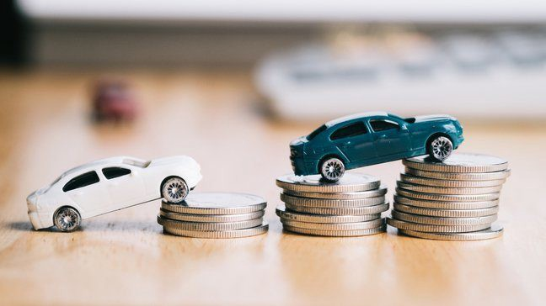
Car Price Prediction
Ankit Soran

Slide 2
AGENDA
01
Problem Statement
Problem Understanding
Uses and Importance of Car Prediction
02
Exploratory data analysis
Visualizations
Data cleaning steps.
03
Model Building
Saving the model and predictions from saved best model
04
Conclusion

Slide 3
Problem Statement
With the covid 19 impact on the market, we have seen lot of changes in the car market. Now some cars are in demand hence making them costly and some are not in demand hence cheaper. one of our clients works with small traders, who sell used cars. With the change in market due to covid 19 impact, our client is facing problems with their previous car price valuation machine learning models. so, they are looking for new machine learning model from new data. we have to make car price valuation model.

Slide 4
Problem Understanding
There are lots of individuals who are interested in the used car market at some point in their life because they wanted to sell their car or buy a used car. In this process, it’s a big corner to pay too much or sell less than its market value. There are one of the biggest target groups that can be interested in the results of this study. If used car sellers better understand what makes a car desirable, what are the important features of a used car, then they may consider this knowledge and offer a better service.
USES of Car Prediction
With the increased prices of new cars and the financial incapability of the customers to buy them, Used Car sales are on a global increase. Therefore, there is an urgent need for a Used Car Price Prediction system that effectively determines the worthiness of the car using a variety of features.

Slide 5
Importance of car prediction:
The prices of new cars in the industry are fixed by the manufacturer with some additional costs incurred by the Government in the form of taxes. So, customers buying a new car can be assured of the money they invest to be worthy. But due to the increased price of new cars and the incapability of customers to buy new cars due to the lack of funds, used cars sales are on a global increase. There is a need for a used car price prediction system to effectively determine the worthiness of the car using a variety of features . Even though there are websites that offer this service, their prediction method may not be the best. Besides, different models and systems may contribute to predicting power for a used car’s actual market value. It is important to know their actual market value while both buying and selling.

Slide 6
Exploratory Data Analysis:
As a first step I have scrapped all the required information from Cars24 website.
I have imported required libraries and I have imported the dataset which was in excel format.
I have also dropped Unnamed:0, duplicates columns and Removing the rows which have missing values as I found they are useless. Then I did all the statistical analysis like checking shape, null values, columns, info, types etc.
Next as a part of feature extraction I converted the data types of all the columns and I have extracted useful information from the raw dataset. Thinking that this data will help us more than raw data.

Slide 7
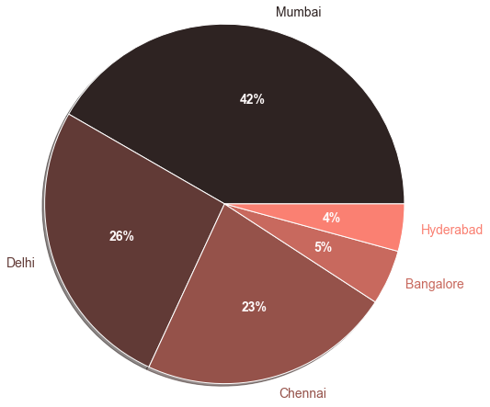
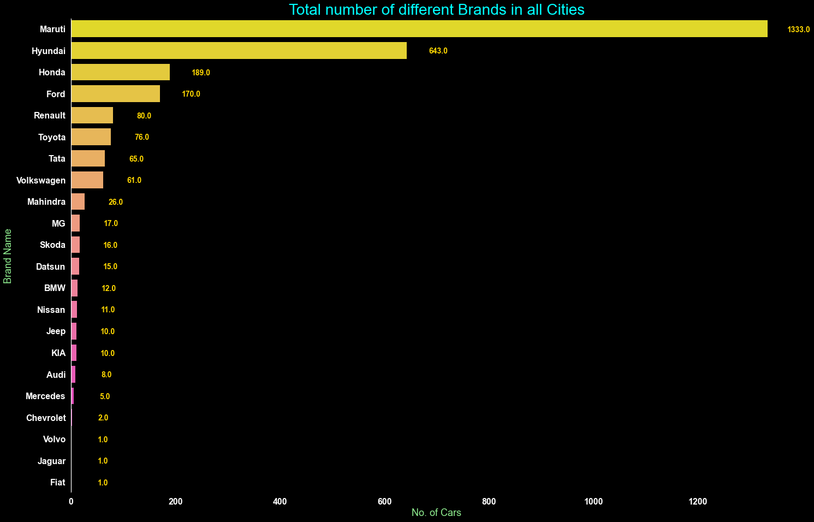
Analysing & Visualizing the Data :
Total number of cars in different cities
Total number of brands in all cities

Slide 8
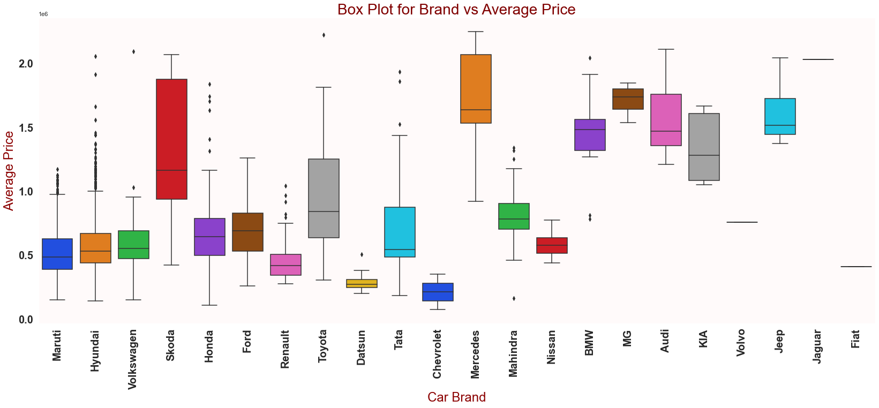
Average price of car brands :

Slide 9
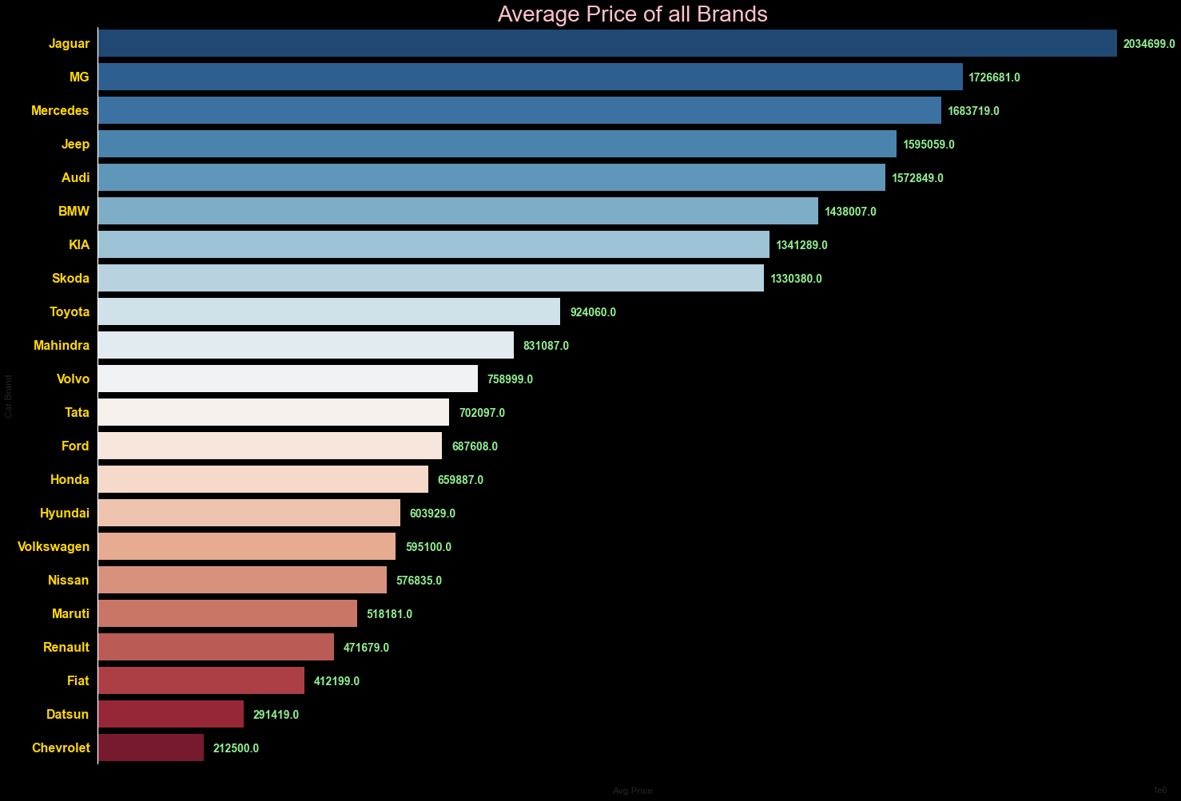
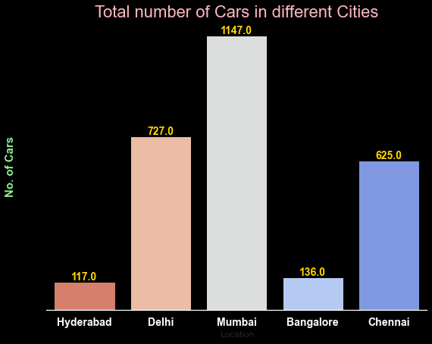
Average price to total number of cars in different cities:

Slide 10
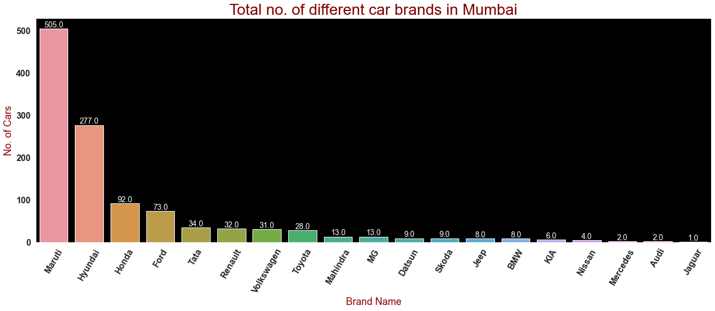
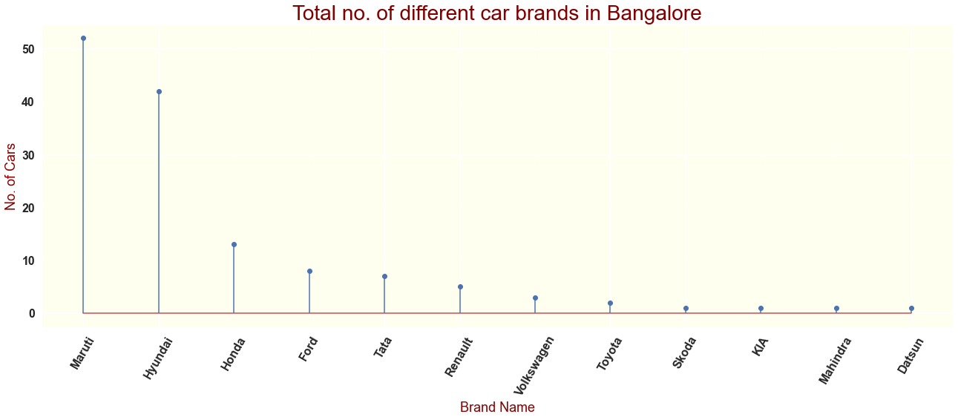
Total no of car brands in Mumbai and Banglore:

Slide 11
Average price of car brands :

Slide 12
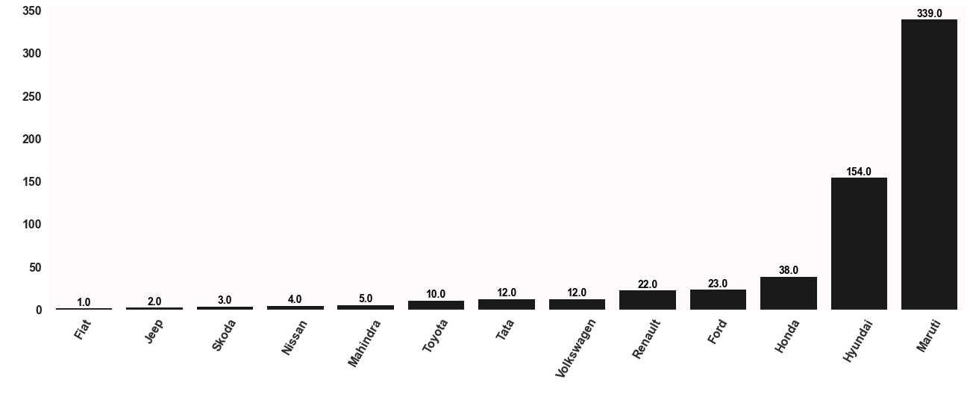
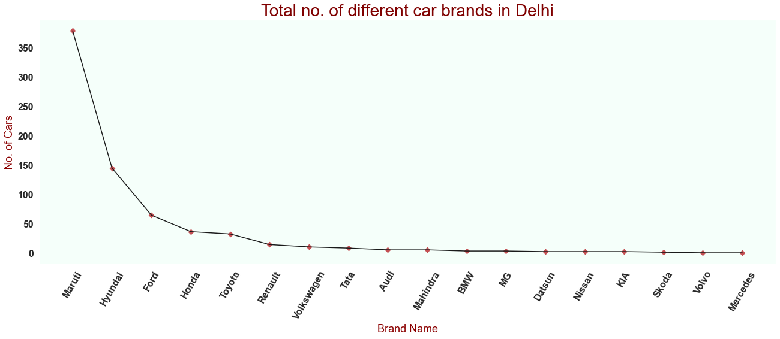
Total number of car brands in Chennai and Delhi:

Slide 13
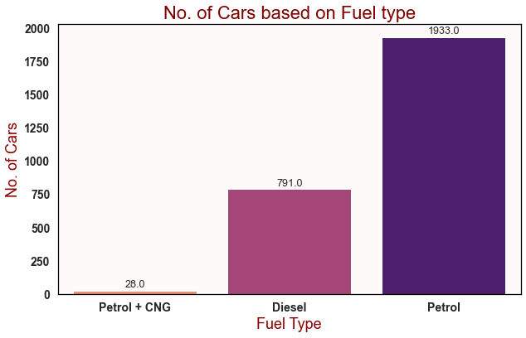
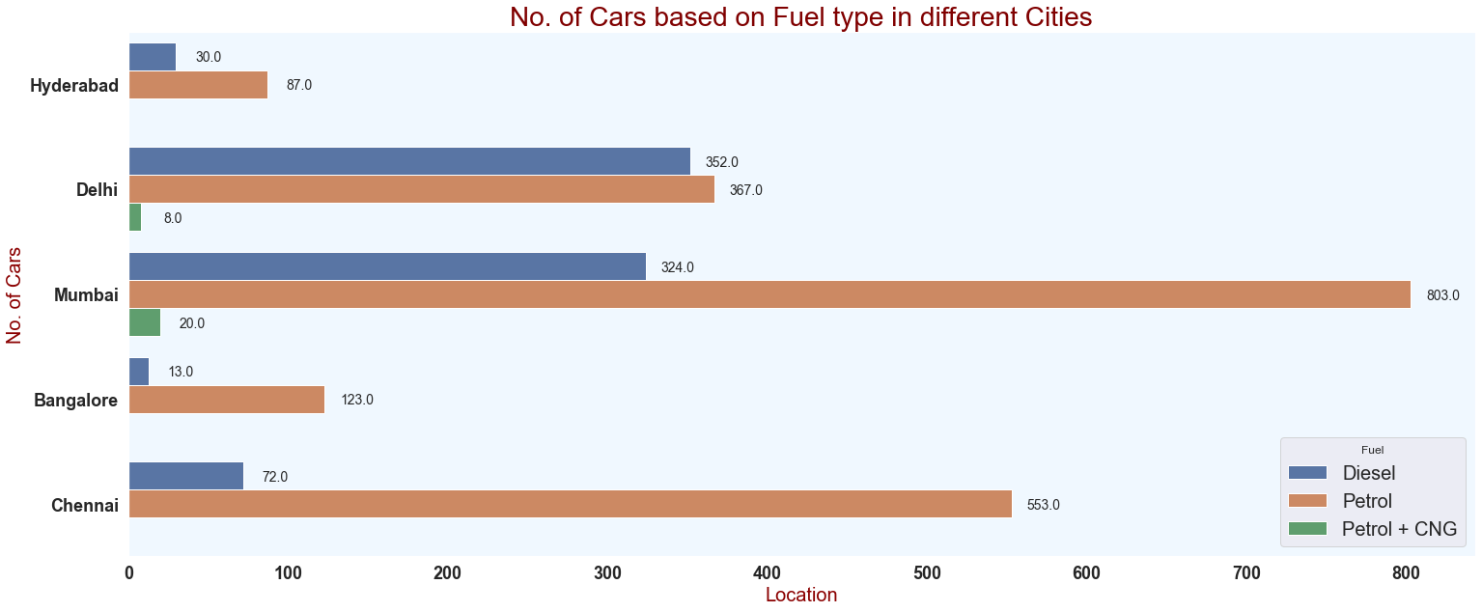
Number of cars based on fuel type:

Slide 14
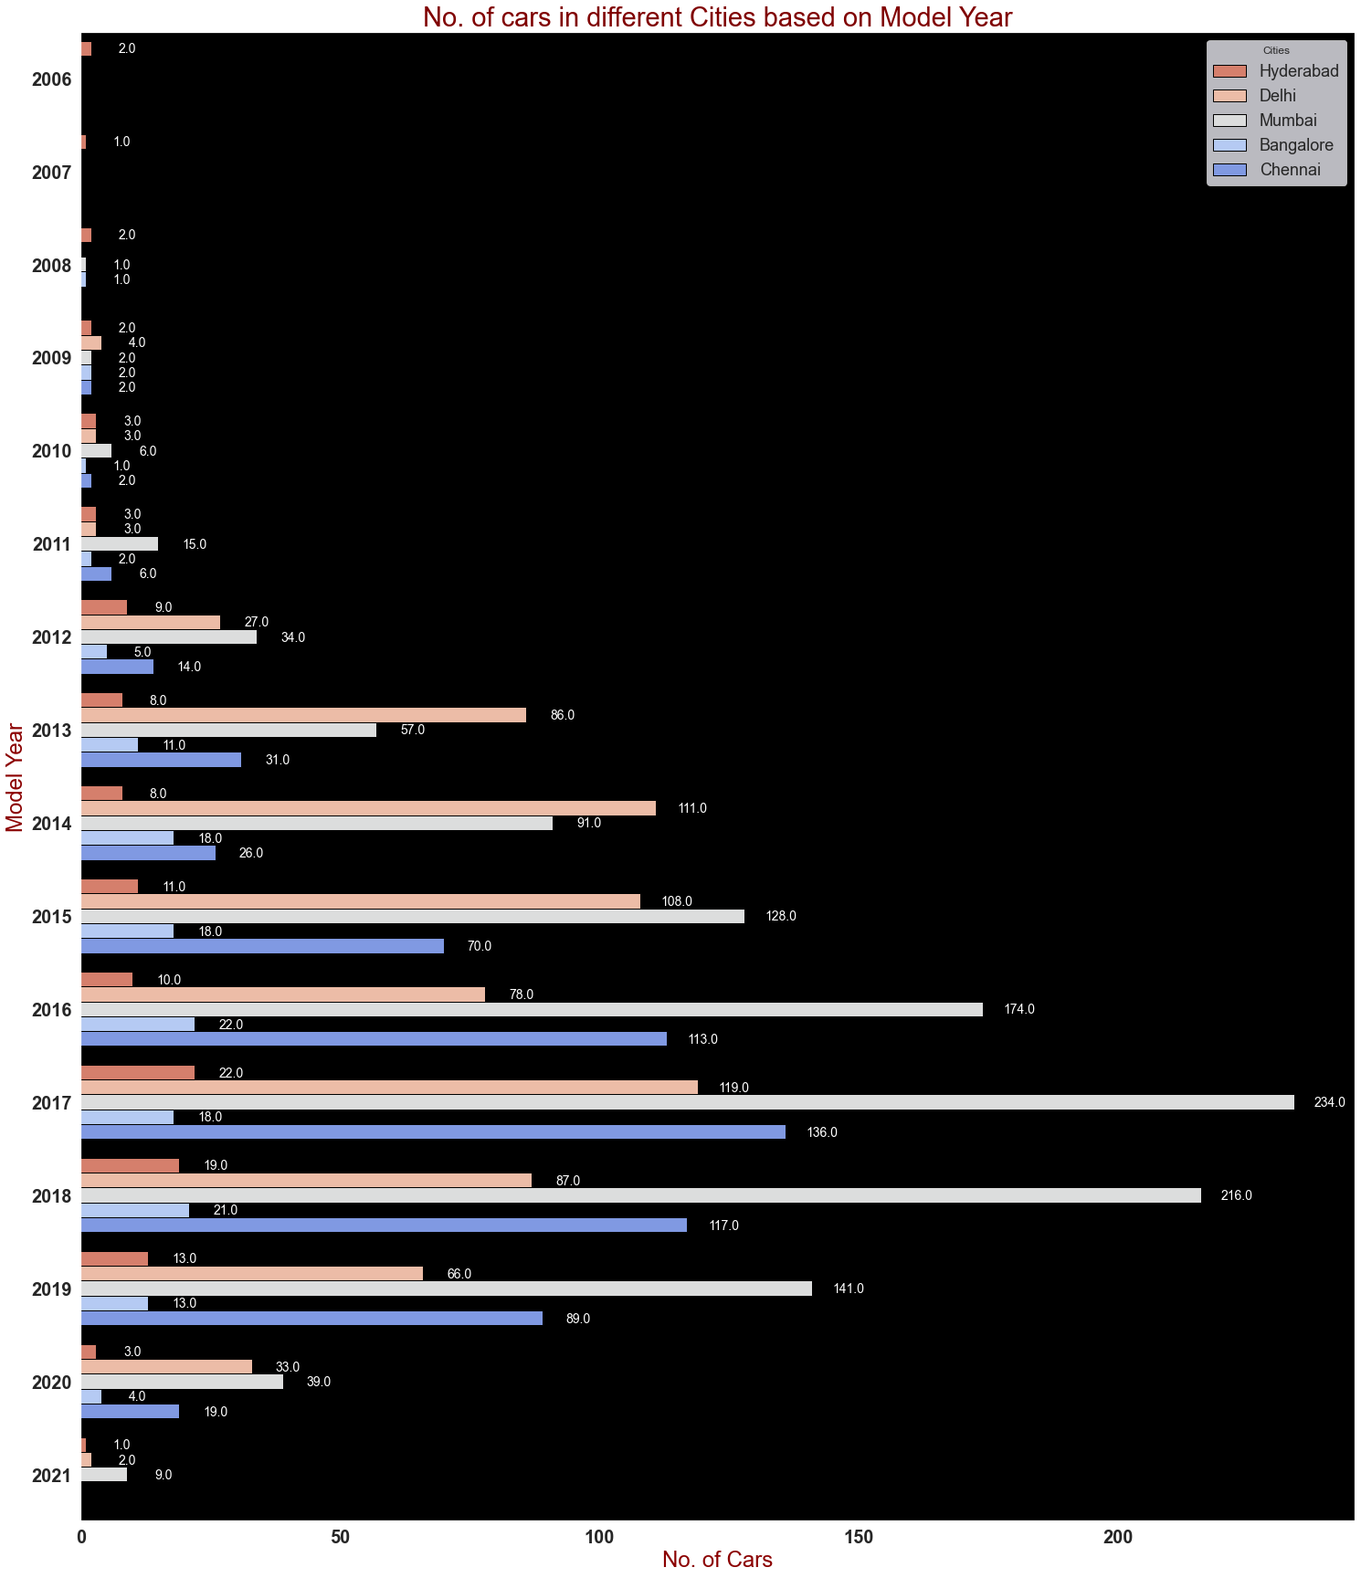
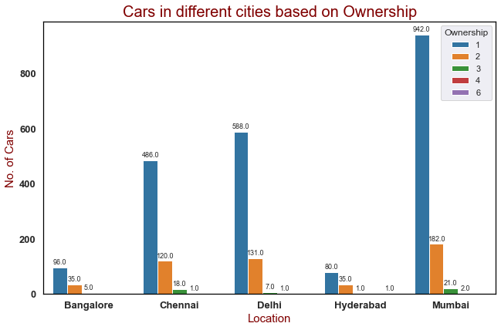
Cars in different cities based on model year and ownership:

Slide 15
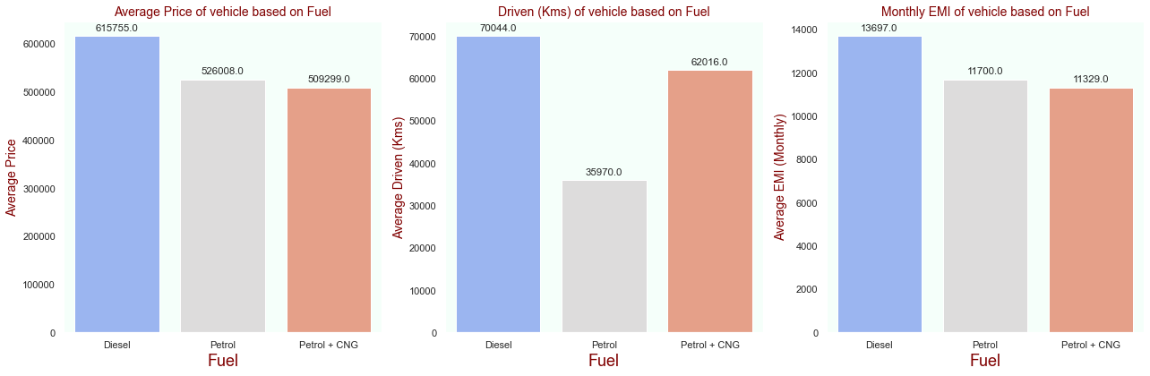
Average price, Driven kilometre, Monthly EMI:

Slide 16
Observations:
For Diesel cars the price is higher compared to petrol and CNG . Cars with automatic gear are costlier than manual gear cars.
Mercedes, Audi, BMW brand cars are having highest sale price when compared to Maruti and so on. In Bangalore, Hyderabad and Delhi-NCR car prices are high as they are highly populated cities.
Most cars are available from year '2014' to '2019' .IN all cities Diesel have done most km in terms if driven in the entire life cycle.

Slide 17
Analysis and Data cleaning:
I have converted data into categorical columns and further we have checked co-relation in features.
I have used bar plot for each of categorical feature that shows the relation with the median car price for all the sub categories in each categorical feature.
I found that there is a linear relationship between continuous numerical variable and Car Price.
We will check the outliers present in the numerical columns.
We have removed skewness using z-score.
Loss percentage is approximately 10%.
we have used VIF(variance inflation factor) to check the multicollinearity although VIF factor is less then 10 for all features hence there is less chance of multicollinearity.

Slide 18
Model Building:
Since Car Price was my target and it was a continuous column so this particular problem was regression problem. And I have used all regression algorithms to build my model. By looking into the difference of r2 score and cross validation score I found Decision Tree Regressor as a best model with least difference. Also to get the best model we have to run through multiple models and to avoid the confusion of overfitting we have go through cross validation. Below are the list of regression algorithms I have used in my project.
Lasso
Ridge
Linear Regression
Kneighbors Regressor
Gradient Boosting Regressor
Decision Tree Regressor

Slide 19
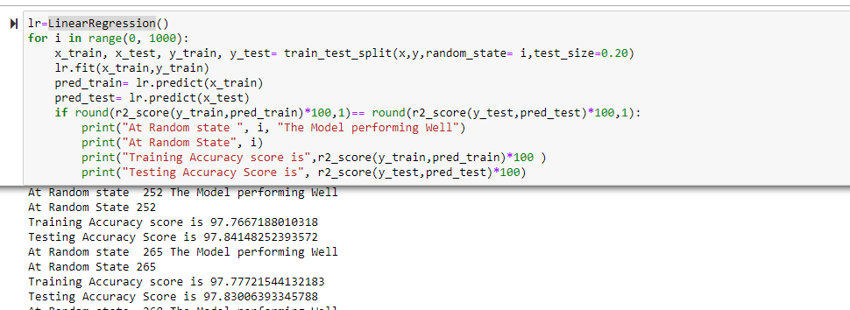
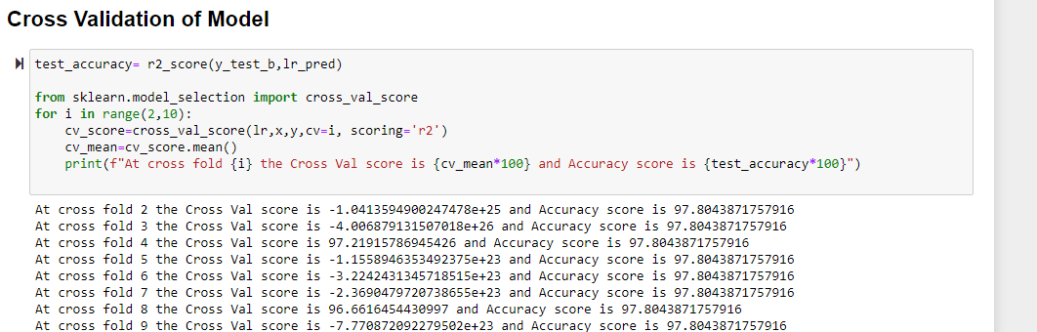
Linear Regression: Accuracy is 97% at all random states and CV score is also same:

Slide 20
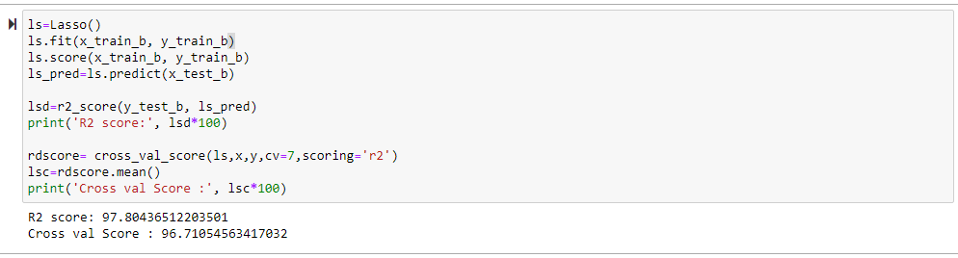
Lasso:

Slide 21
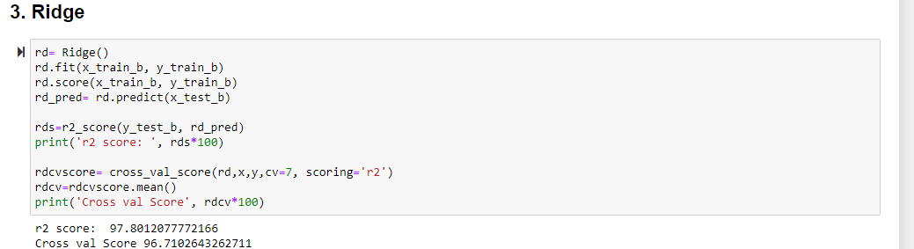
Ridge:

Slide 22
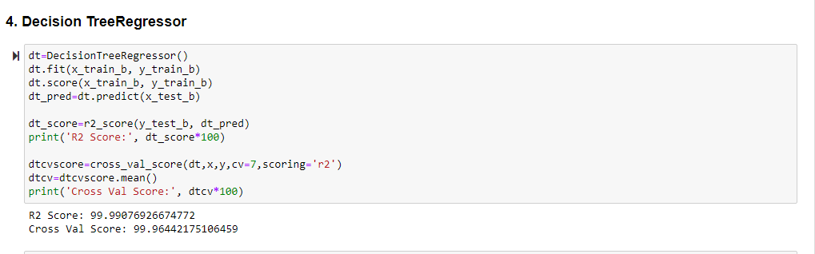
Decision Tree Regressor:

Slide 23
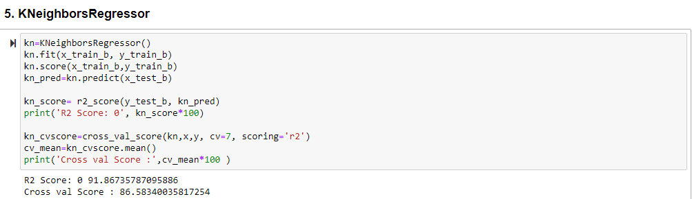
Kneighbors Regressor:

Slide 24
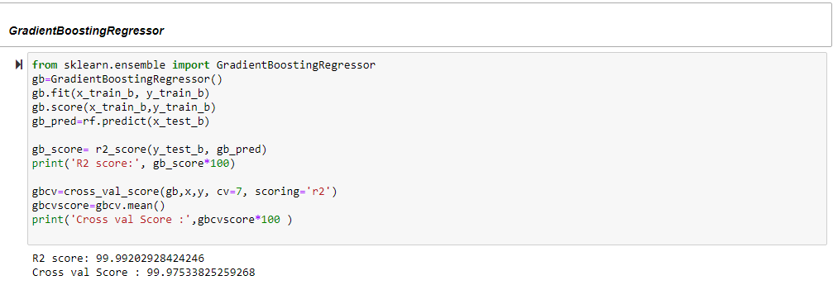
Gradient Boosting Regressor:

Slide 25
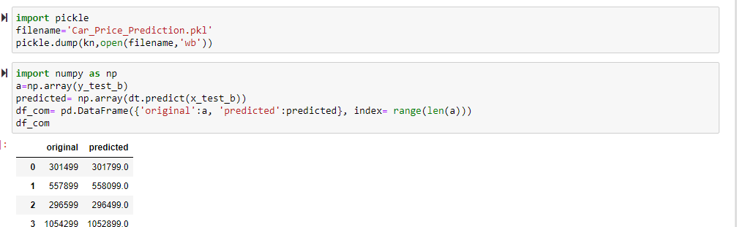
Saving the model and predictions using saved model:
Saving the model and predictions using saved model.
I have saved my best model using .pkl as follows.
Now after saving the best model, loading my saved model and predicting the price values.
I have predicted the Car Price using saved model, and the predictions look good.
The Predicted values are almost same as actual values.

Slide 26
Conclusion
In this project report, we have used machine learning algorithms to predict the used car price. We have mentioned the step by step procedure to analyse the dataset and finding the correlation between the features. Thus we can select the features which are correlated to each other and are independent in nature. The power of visualization has helped us in understanding the data by graphical representation it has made me to understand what data is trying to say.
Data cleaning is one of the most important steps to remove unrealistic values and unnecessary values. These feature set were then given as an input to five algorithms. Hence we calculated the performance of each model using different performance metrics and compared them based on these metrics. Then we have also saved the best model and predicted the car price. It was good that the predicted and actual values were almost same.
To conclude, the application of machine learning in car price prediction is still at an early stage. We hope this study has moved a small step ahead in providing some methodological and empirical contributions to online platforms, and presenting an alternative approach to the valuation of used car price. Future direction of research may consider incorporating additional used car data from a larger economical background with more features.

Slide 27
Conclusion
Thankyou

